Slide 1

The Infamous Five Color Theorem
Dan Teague
NC School of Science and Mathematics
teague@ncssm.edu

Slide 2
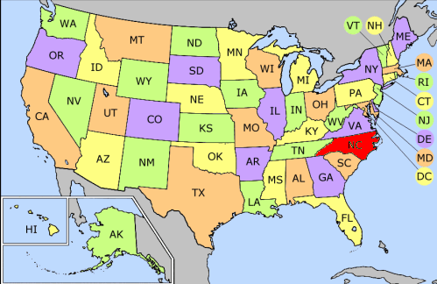
5-coloring of the continental US

Slide 3
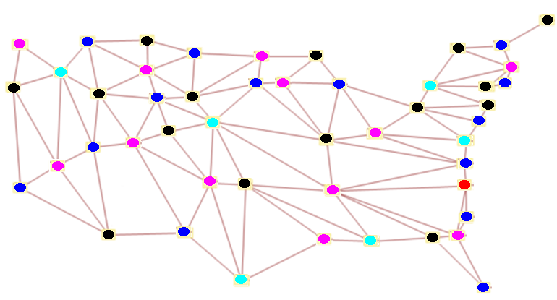
5-color vertex coloring of the continental US

Slide 4
Augustus de Morgan, Oct. 23, 1852
In a letter to Sir William Hamilton,
A student of mine asked me today to give him a reason for a fact which I did not know was a fact - and do not yet.
He says that if a figure be anyhow divided and the compartments differently coloured so that figures with any portion of common boundary line are differently coloured - four colours may be wanted, but not more….
Query cannot a necessity for five or more be invented. ...... If you retort with some very simple case which makes me out a stupid animal, I think I must do as the Sphynx did....

Slide 5
Hamilton, Oct. 26, 1852
I am not likely to attempt your quaternion of colour very soon.
The first published reference is by Authur Cayley in 1879 who credits the conjecture to De Morgan.

Slide 6
The Four Color Problem: Assaults and Conquest by Saaty and Kainen, 1986,p.8.
The great mathematician, Herman Minkowski, once told his students that the 4-Color Conjecture had not been settled because only third-rate mathematicians had concerned themselves with it. "I believe I can prove it," he declared.
After a long period, he admitted, "Heaven is angered by my arrogance; my proof is also defective.”

Slide 7
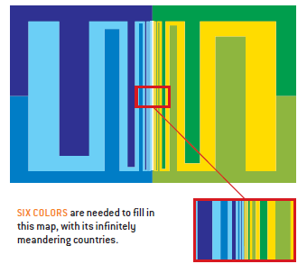
Hud Hudson,
Western Washington University
“Four Colors do not Suffice” The American Mathematical Monthly Vol. 110, No. 5, (2003): 417-423.

Slide 8
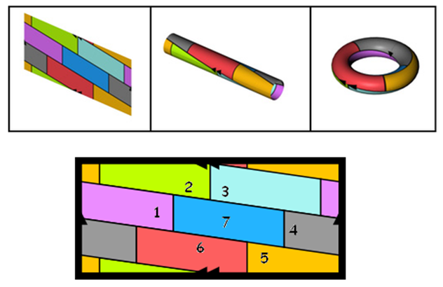
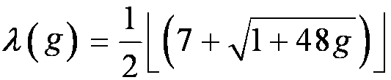
George Musser, January, 2003 Scientific American
Science operates according to a law of conservation of difficulty. The simplest questions have the hardest answers; to get an easier answer, you need to ask a more complicated question. The four-color theorem in math is a particularly egregious case

Slide 9
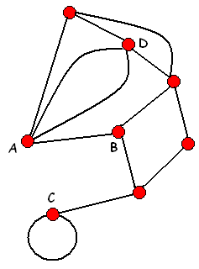
Fundamentals of Graphs
A graph consists of a finite non-empty collection of vertices and a finite collection of edges (unordered pairs of vertices) joining those vertices.
Two vertices are adjacent if they have a joining edge. An edge joining two vertices is said to be incident to its end points.
The degree of a vertex v is the number of edges which are incident to v.

Slide 10

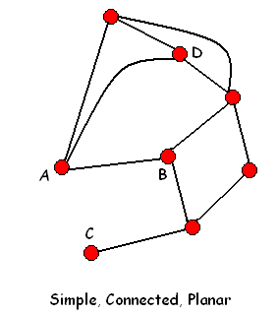
Simple, Connected, Planer Graphs
A simple graph has no loops or multiple edges.
A graph is planar if it can be drawn in the plane without edges crossing.

Slide 11
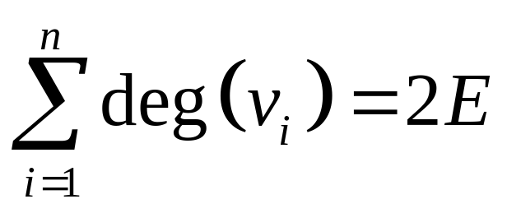
Basic Theorems
Handshaking Lemma:
In any graph, the sum of the degrees of the vertices is equal to twice the number
of edges.

Slide 12
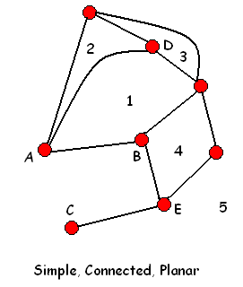
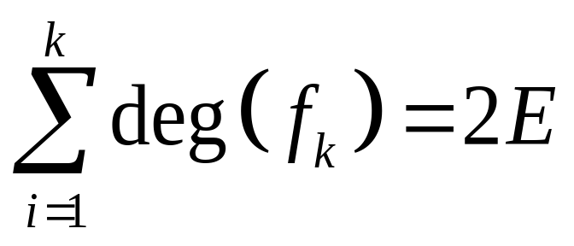
Planar Handshaking Theorem
In any planar graph, the sum of the degrees of the faces is equal to twice the number of edges.

Slide 13
Euler’s Formula
In any connected planar graph
with V vertices, E edges, and
F faces,
V – E + F = 2.

Slide 14
V – E + F = 2
To see this, just build the graph. Begin with a single vertex.
1) Add a loop.
2) Add a vertex (which requires and edge).
3) Add an edge.

Slide 15
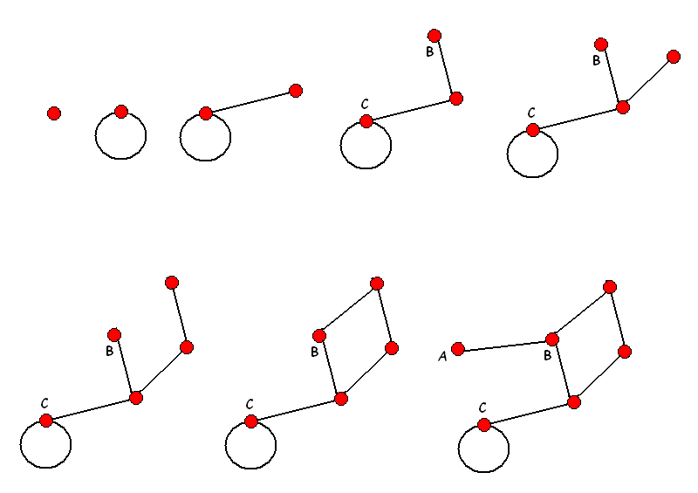
V – E + F = 2

Slide 16
Two Theorems
Two theorems are important in our approach to the 4-color problem.
The first puts and upper bound to the number of edges a simple planar graph with V vertices can have.
The second puts an upper bound on the degree of the vertex of smallest degree.

Slide 17
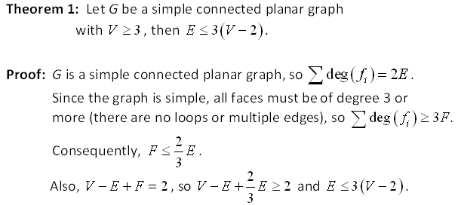

Slide 18
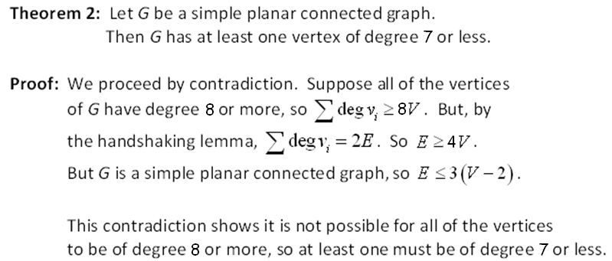
Initial Question

Slide 19
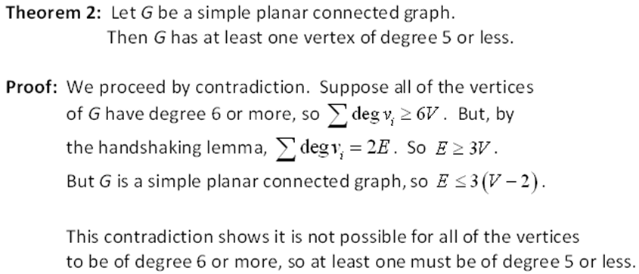

Slide 20
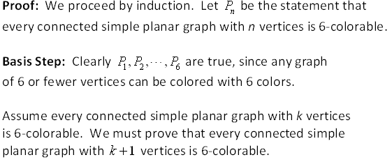
The 6-Color Theorem: Every connected simple planar graph is
6-colorable.

Slide 21
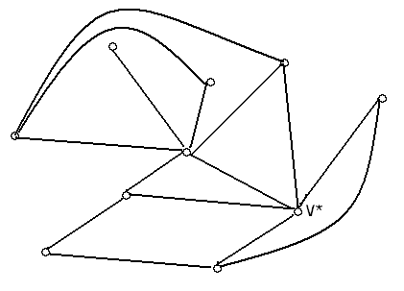
Consider a SCP graph with (k+1) vertices.
Find v* with degree 5 or less

Slide 22
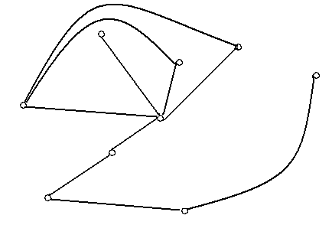
Remove v* and all incident edges. The resulting subgraph has k vertices.

Slide 23
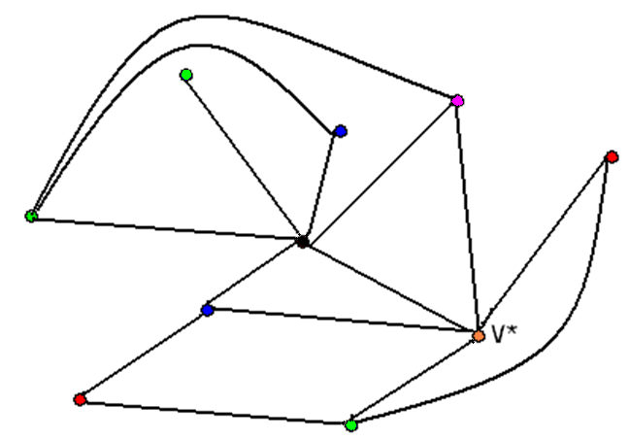
Color G.
Replace v* and incident edges. Since we have 6 colors and at most 5 adjacent vertices…
Life if Good.

Slide 24
The 5-Color Theorem:
All SCP graphs are 5 colorable.
Proof: Proceed as before. Clearly, any connected simple planar graph with 5 or fewer vertices is 5-colorable. This forms our basis.
Assume every connected simple planar graphs with k vertices is 5-colorable.

Slide 25
Let G be a connected simple planar graph with (k+1) vertices. There is at least one vertex, v*, with degree 5 or less.

Slide 26
Remove this vertex and all edges incident to it. Now, the remaining graph with k vertices, denoted , is 5-colorable by our assumption.

Slide 27
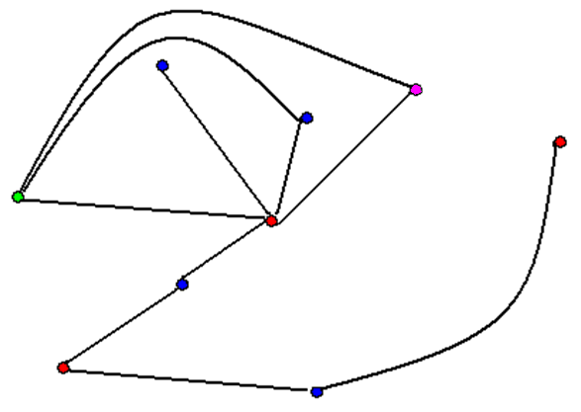
Color this graph with 5 colors.

Slide 28
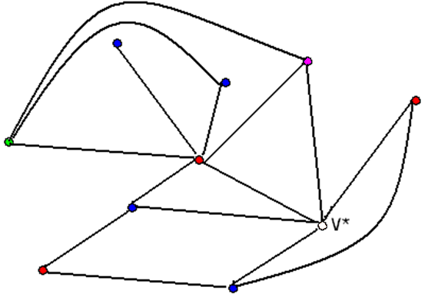
Replace v* and the incident edges. Can we color v*?

Slide 29
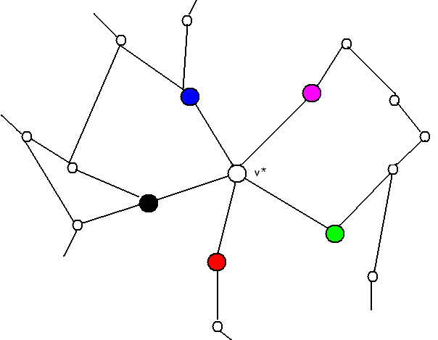
Consider a M-G path (path alternates Magenta-Green-Magenta-Green-…)

Slide 30
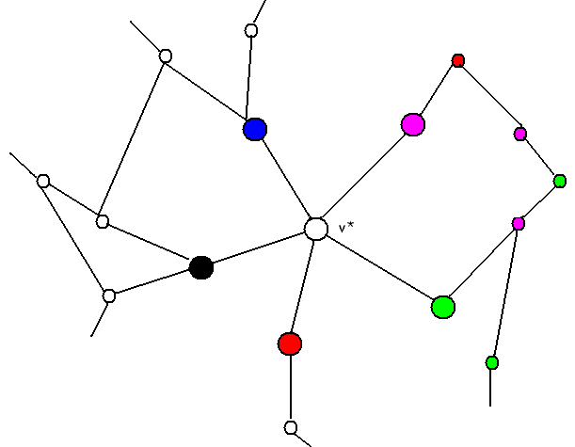
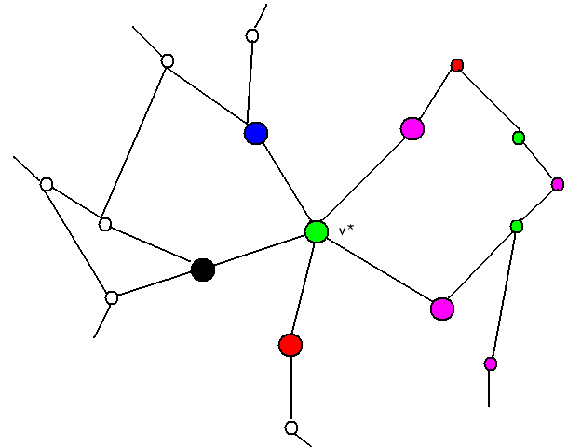
No Path?
Switch M and G and everything is fine

Slide 31
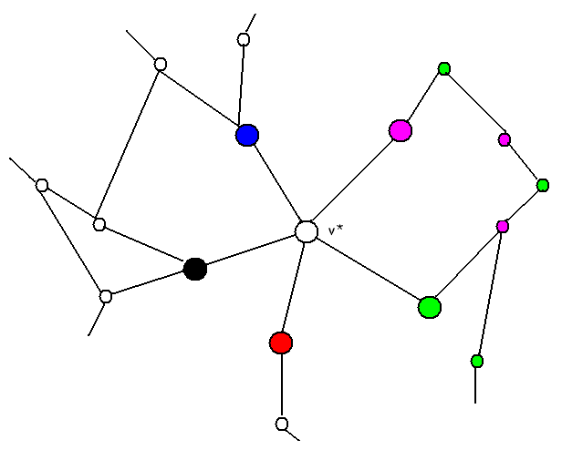
If Yes. Switch doesn’t help.

Slide 32
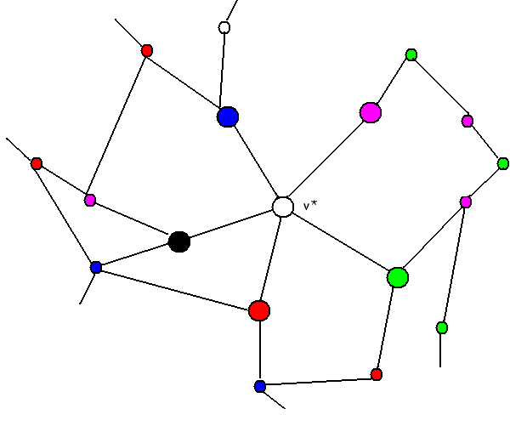
Is there a R-B chain?

Slide 33
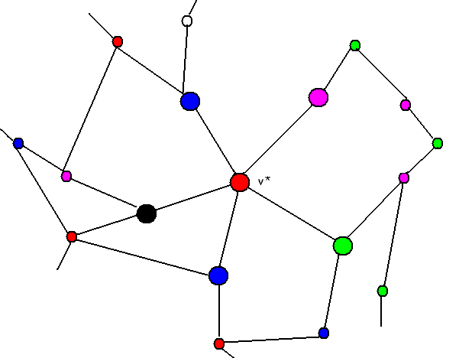
No? Switch R and B.
Color v* Red

Slide 34
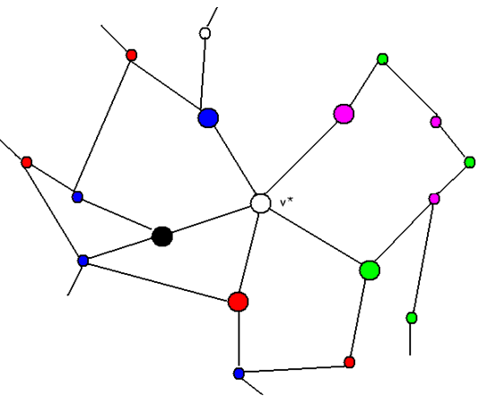
But, Suppose Yes?

Slide 35
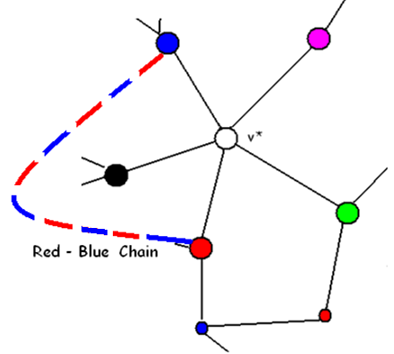
But, if there is a Red-Blue Chain, there cannot be a Black – Green Chain

Slide 36
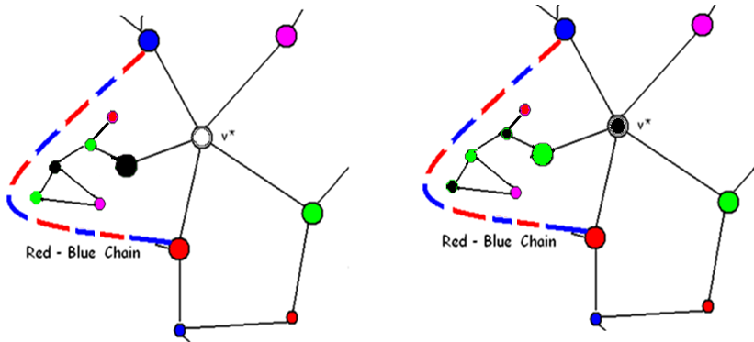
Switch Black and Green. Color v* Black

Slide 37
5-Color Theorem proved by Heawood in 1890 using Kempe chain
By the Kempe Chain argument, if we can 5-color a k-vertex graph we can 5-color a (k+1)-vertex graph, and the 5-color theorem is true for all n-vertex graphs.

Slide 38
Use the Kempe Chain to prove Big Brother, the 4-Color Theorem
Every SCP planar graph is 4-colorable.
Proof: Proceed as before. Clearly, any connected simple planar graph with 4 vertices is 4-colorable. This forms our basis.
Assume all connected simple planar graphs with k vertices are 4-colorable.

Slide 39
At what point must we alter the argument?
Let G be a connected simple planar graph with (k+1) vertices.
There is at least one vertex, v*, with degree 5 or less.
Remove this vertex and all edges incident to it.
Now, the remaining graph with k vertices is 4-colorable by our assumption. Color this graph with 4 colors. Replace v* and the incident edges.
What’s the problem?

Slide 40
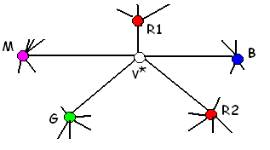
The worst case

Slide 41
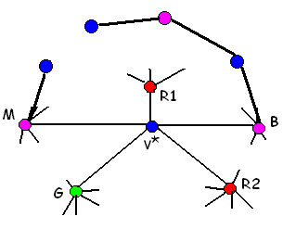
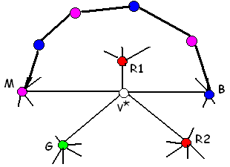
Is there a Blue-Magenta (B-M) Chain?
If not, then switch Blue and Magenta and we can color v*.

Slide 42
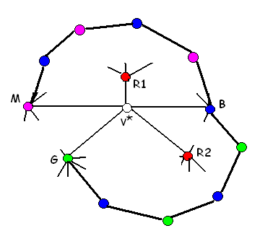
If yes, then is there also a Blue-Green chain?
If no, then switch Blue and Green and we can color v*.

Slide 43
If there are both B-M and B-G chains, then what?
There can’t be a M-R2 chain or a G-R1 chain.

Slide 44
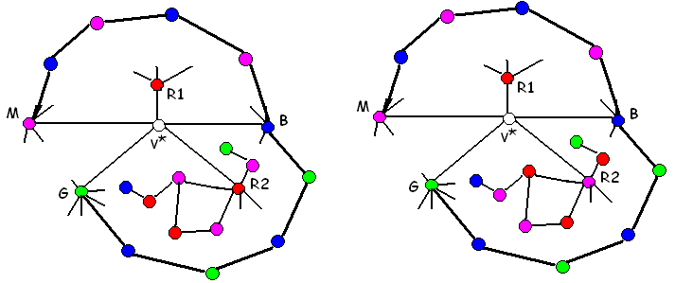
Switch Magenta and Red 2

Slide 45
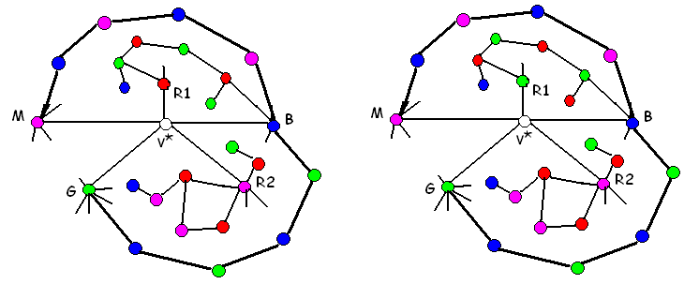
And Switch Green and Red 1

Slide 46
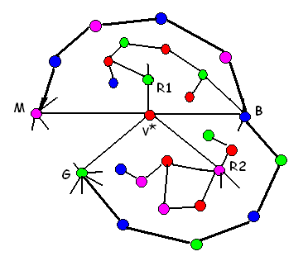
Color v* Red.

Slide 47
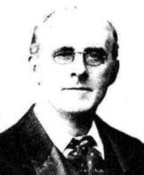
Alfred Kempe’s (1849-1922)
1879 Proof (2nd issue of the American Journal of Mathematics)
Elected Fellow of the Royal Society in 1881.

Slide 48
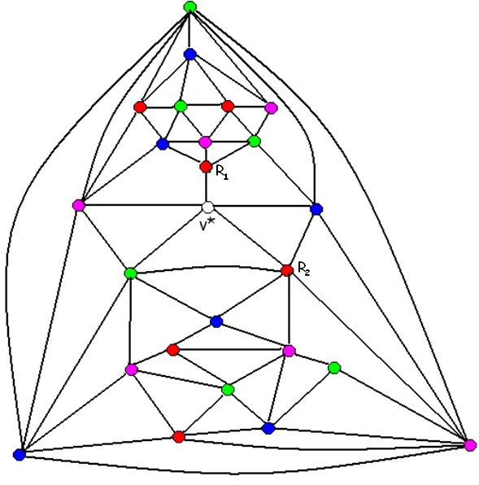

Slide 49
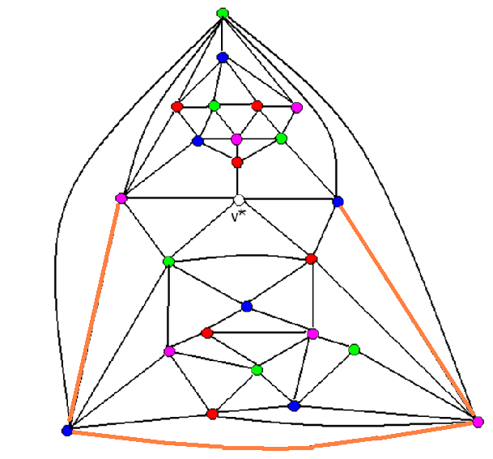
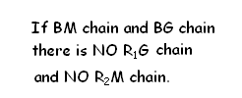

Slide 50
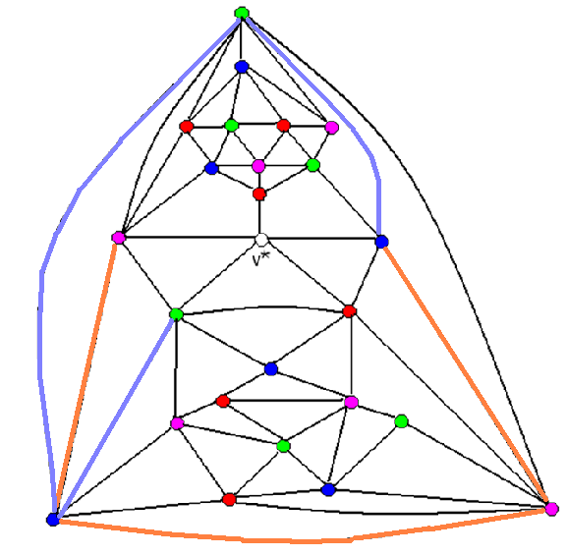

Slide 51
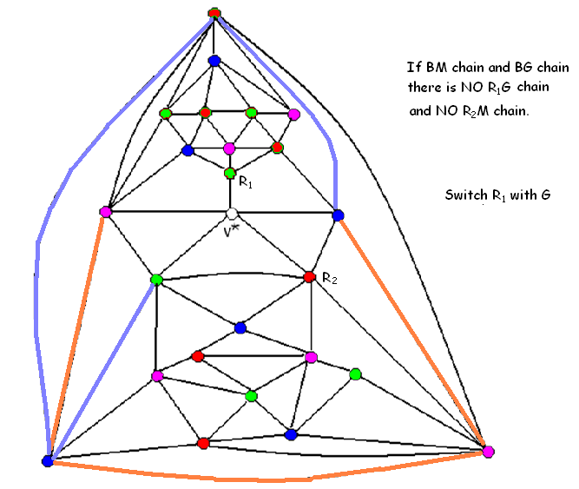

Slide 52
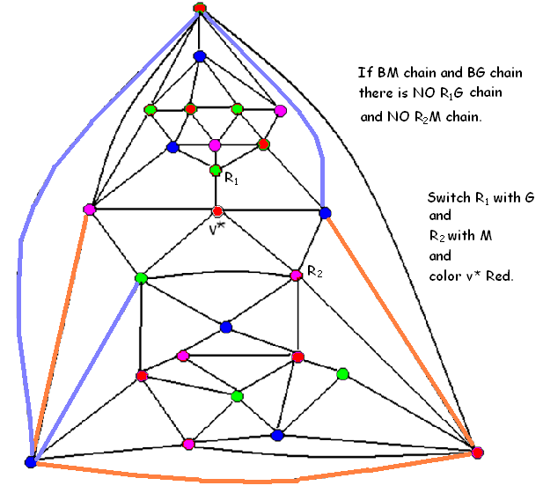

Slide 53
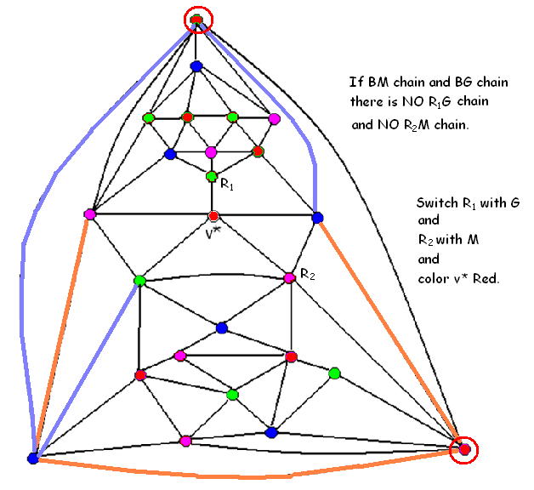

Slide 54
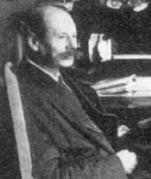
Percy John Heawood (1861-1955)

Slide 55
Big Brother 4-color
So, it was left to Kenneth Appel and Wolfgang Haken in 1976 with
1200 hours of supercomputer time
50 pages of text and diagrams
86 additional pages of diagrams (@2,500)
400 microfiche pages with diagrams and thousands of verifications of individual claims.
N. Robertson, D. P. Sanders, P. D. Seymour and R. Thomas in 1997.

Slide 56
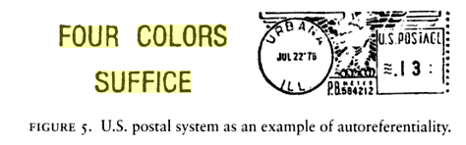
July 22, 1975 postmark

Slide 57
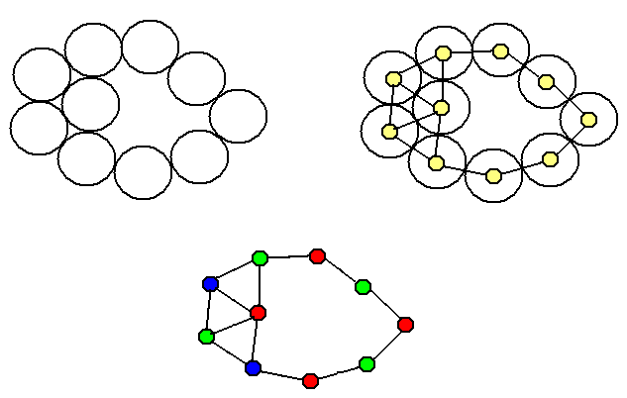
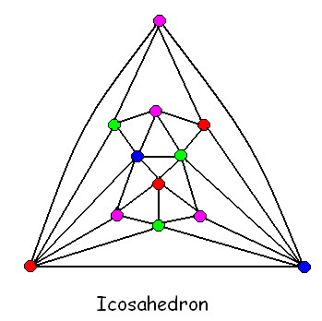
Students can prove that all SCP graphs with
V < 12 and all coin-graphs are Four Colorable.

